Slide 1
S3D Custom Commands - Activity
TS-TR-001
22-05-2024
00
- Manoj Lalsare

Slide 2
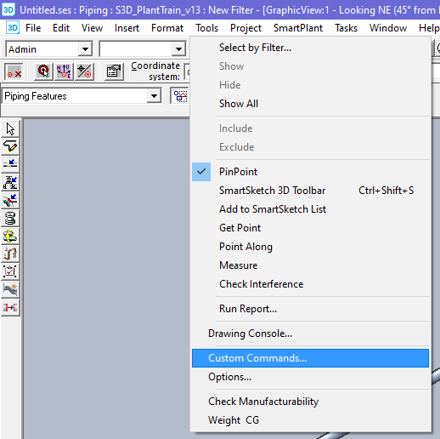
Steps:
Create VB.net Solution for Set Object Property Value Custom Command.
Build Solution.
Copy DLL to C:\Program Files (x86)\Smart3D\3DRefData\SharedContent\CustomCommands
Open S3D. Go to Tools > Custom Commands…

Slide 3
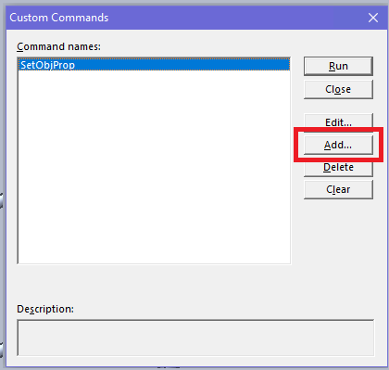
Click Add…

Slide 4
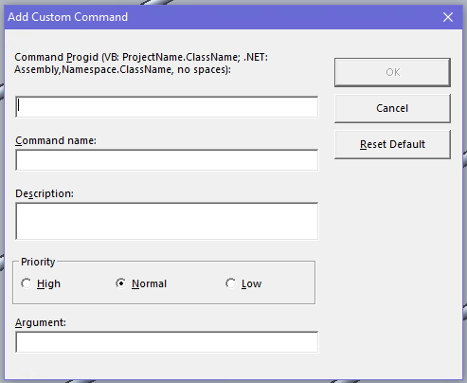
Enter Prog ID on the first Text Box.
ProgID: ( TSTrainingCommands,TSTrainingCommands.SetObjPropCmd )
Enter Command Name (Optional/Any name)

Slide 5
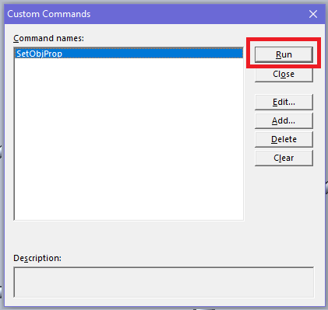
Select Custom Command then Click Run

